Slide 1
Multimodal Data Fusion and Activity Recognition in an Intelligent Multimedia Classroom System
— The Second Portion of the Second Exam (Dissertation Proposal)
Weihong Li
Advisor: Prof. Zhigang Zhu
Committees:
Prof. Robert M. Haralick
Prof. Esther Levin
Prof. George Wolberg
Dr. Michael Chan
Notes:
Today, I will be talking about …., which is my second part of the second exam.

Slide 2
Outline
Introduction
Previous Results
  Multimedia Integration
  Multimedia Presentation
  Speaker Tracking
Research Proposal
  Active Objects based Interaction
  Multimodal Layered HMM (ML-HMM)
Summary, Discussion and Timeline
Notes:
This is the outline of my talk:
First I will brief introduce our IMC system and related work.
Then, I am gonna show you some preliminary results.
After that, I will talk about the research proposal, and finally, I will conclude my talk and discuss the time line for the proposed research.

Slide 3
Outline
Introduction
Previous Results
  Multimedia Integration
  Multimedia Presentation
  Speaker Tracking
Research Proposal
  Active Objects based Interaction
  Multimodal Layered HMM (ML-HMM)
Summary, Discussion and Timeline
Notes:
Let’s first take a look at some introduction.

Slide 4
Introduction
Intelligent Multimedia Classroom (IMC)
  Automatic data collection, integration and presentation
  Flexible interaction based on active objects
  Real-time multimodal activities recognition
Related Work
Proposed Thesis Work
  Active objects
  Layered probabilistic model
Notes:
In the introduction part, I will first introduce our IMC system, which includes 3 components: …
Followed by the introduction of related work.
Finally, I will brief introduce our proposed work for thesis defense, which includes 2 main tasks:
active multimedia objects for advanced presentation and instructor-student interaction
a layered probabilistic models for multimodal activities recognition for intelligent instructor assisting

Slide 5
Intelligent Multimedia Classroom
Automatic data collection, integration and presentation
  Audio, Video, PPT slides, Mimio handwriting
Flexible interaction via active objects
  Speaker contour
  Terminology
  Table of content (TOC)
Real-time multimodal activities recognition
  Multimodal Layered hidden Markov model (ML-HMM)
Notes:
5: this slide; 13: sensors;
In our standard classroom settings, we assume a whiteboard is used and the instructor will use the following devices and tools in the classroom.
Camera: to videotape the classroom materials.
Laptop with PPT and its add-on installed, which is used to capture PPT slides and some operation history log.
Mimio handwriting digitizer: mounted on whiteboard to capture the handwriting. When the marker pen is used to write something on the whiteboard, the ultrasonic signal will be sent to the mimio system, and the location of the pen is calculated by the triangulation of the two receivers.
In the Intelligent Multimedia Classroom, we are aiming to create a natural environment that could improve interaction between students and the instructor. This will be enabled by the concept of active media objects in the Intelligent Multimedia Classroom,
Recognizing important activities or events in classroom scenario could be very useful for both lecturers and students. Detecting the event of an instructor's always staying in front of the slide projection area indicates an occlusion for students; hence a reminder might be friendly delivered to the instructor to step away for a while.
We propose a multimodal fusion approach with a layered probabilistic framework to recognize all these activities in real time and provide more efficient e-lectures for both online and offline applications
We will take a detailed look at these components later.

Slide 6
Related Work
Record and Playback Systems:
  Classroom 2000 (Georgia Tech)
  Just-In-Time (CMU)
  RIPPLES/MANIC (UMass-Amherst)
Interaction Projects:
  Augmented Classroom (Geys and Van Gool)
  Intelligent Classroom (Franklin, et al)
Event Recognition Systems:
  Meeting room activities recognition (Zhang, et al)
  Office actions recognition (Oliver, Horvitz and Garg)
Notes:
The first generation of e-learning system mainly adopted a record-and-playback strategy. Including classroom 2000 project conducted in Georgia Tech. Just-In-Time System from CMU and Ripples/Manic project in Umass at Amherst
Another related project is the interaction projects, including AC, by Geys and Van Gool. They proposed an interaction and augmented classroom project based on laser pointer tracking approach.The Intelligent Classroom uses cameras and microphones to determine what the speaker is trying to do and then takes the actions (e.g., jumping to a new slide) it deems appropriate The goal of Intelligent Classroom is to control automated VCRs and slide projectors and to produce a video of the presentation
Events and activities recognition has been long interesting research topic for researchers and application developers. a two-layer hidden Markov model is proposed by Zhang, et al. for modeling individual and group activities in meeting room
A real time multimodal based office actions recognition system is proposed by Oliver and Horvitz at MSR and a PhD student at UIUC to infer some activities in office scenario. The architecture of their model is similar to ours, but their work is different from us in the following aspects:
Their work is in an office environment, and ours is in classroom, therefore, the activities to be recognized are totally different.
The data sources are different, they are using video, audio plus a history of keyboard and mouse activities.
Because the difference of the data sources and activities, the feature they extracted is totally different from ours.

Slide 7
Proposed Thesis Work
Active Objects
  Extraction
  Presentation
Multimodal Layered HMM (ML-HMM)
  Feature extraction and selection
  Time granularity for each layer
  Modularity based learning and classification
  Performance evaluation
  Adding new activities
Notes:
The research focus of my thesis work will be on (1) active multimedia objects for advanced presentation and instructor-student interaction; and (2) a layered probabilistic model for multimodal activities recognition for intelligent instructor assisting.
First, We propose to use a novel approach, namely active objects, to achieve flexible interaction between students and instructors. We will study how to efficiently and accurately extract these active objects from classroom scenario.
Like speaker contour, mimio and PPT word extraction.
We will also study how to represent these objects and later present these objects to the customs.
We will study the feature extraction and selection for activity and event recognition.
We will explore how to determine the time granularity for each layer.
We will also explore modularity based learning and classification based on the ML-HMM
We will do the experiments to study the performance between ML-HMM and regular HMM as well as single modality based LHMM v.s. multiple modality based LHMM.
We will also explore how hard to add new activities into existed ML-HMM.
More information, such as …,…,.. regarding to these proposed theis work will be discussed later.

Slide 8
Outline
Introduction
Previous Results
  Multimedia Integration
  Multimedia Presentation
  Speaker Tracking
Research Proposal
  Active Objects based Interaction
  Multimodal Layered HMM (ML-HMM)
Summary, Discussion and Timeline
Notes:
Now let’s take a look at the preliminary results.

Slide 9
Previous Results
Multimedia Integration
Multimedia Presentation
Speaker Tracking
  Background subtraction based tracking
  Particle Filtering (PF) based tracking
IMC Integrated with various languages
  C++ for multimedia integration
  Java for multimedia presentation
  Visual Basic for PPT capture add-on
  Matlab for vision-based speaker tracking
Notes:
In this part, I will show you the results of multimedia integration and presentation.
Speaker tracking by background subtraction and particle filtering.
The code for our intelligent multimedia classroom system was written in various computing languages and mostly integrated in the IMC system: C++ code for multimedia integration, Java code for multimedia presentation, Visual Basic code for the PPT capture add-on, and Matlab code for vision-based speaker tracking.

Slide 10
Multimedia Integration
Problem Statement
Static Approach
  Corner Marking Manually
  Drawbacks & Limitations
Dynamic Approach
  Slide & Video Registration
  Video & Whiteboard Registration
  Slide & Whiteboard Integration (Results)
Notes:
Motivation: In our classroom system, we assume the instructor is making notes on the whiteboard with the PPT slides projected on it. To delivery the both the ppt slide and notes, one way is open them in separate windows. However, by doing this way, it is not easy for students to associate the notes with the slides. To solve this problem, we could record the ppt slide and notes using camera. But the ppt slides recorded is a low resolution and is hard to read. So, it will be perfect if students could have an integrated image with both high resolution ppt slides and handwriting notes.
Two approaches, namely S and D approach are proposed here to solve this problem
Static approach is simple but has some limitations and drawbacks.

Slide 11
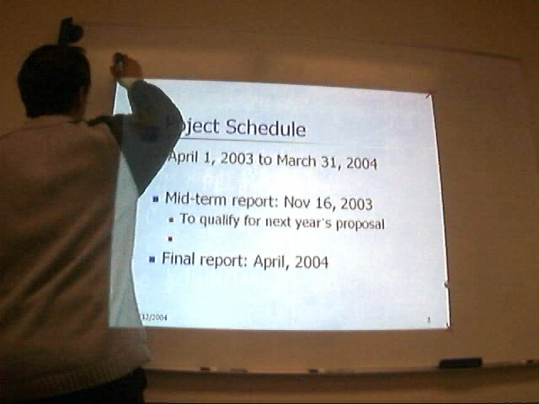

Static Approach
Mark four corners to register slide and mimio handwriting …
Notes:
Basically, to match these two image, we have to get the 3x3 planar projective transformation matrix, which has 8 parameters. Therefore, 4 non-collinear corresponding points are enough, since each corresponding point will give two equations, namely, x and y coordinates.
Hence, In static approach, an instructor is asked to mark the 4 corners of the projection area.
Once we get the 3x3 planar projective transformation matrix, the alignment of the ppt slide image with its corresponding mimio handwriting image is just a trivial work.

Slide 12
Dynamic Approach
Drawbacks of the Static Integration
  Hard to mark in some cases
    due to self-occlusion and height
  Instructor may forget to do it
  Devices may not be kept stationary
    camera, projector, Mimio capture bar
Dynamic Integration Algorithms
  Slide & Video Registration
  Video & Whiteboard Registration
  Slide & Whiteboard Integration (Results)
Notes:
However, this simple approach has a bunch of drawbacks…..
So a dynamic integration approach is proposed, which includes ….

Slide 13
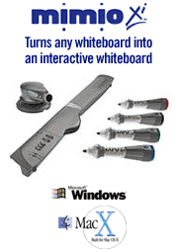
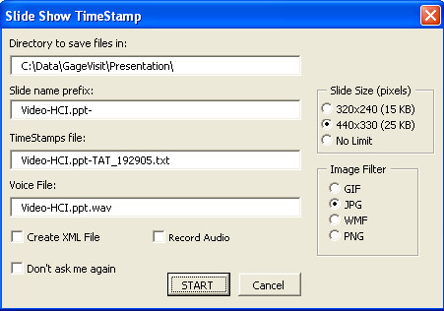

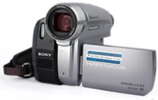
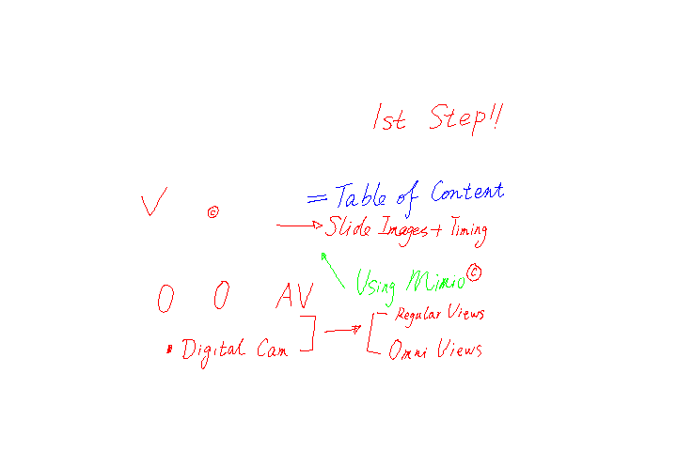
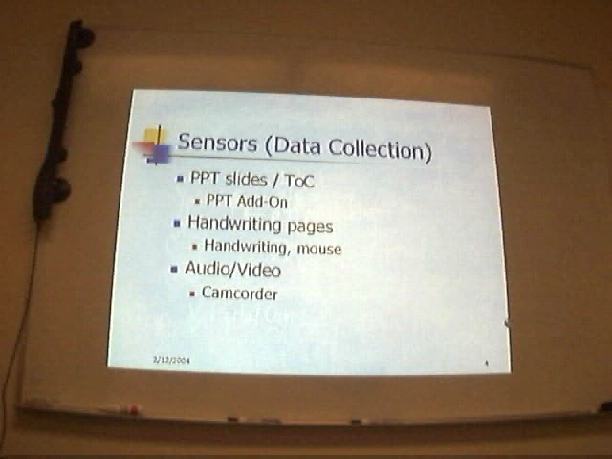
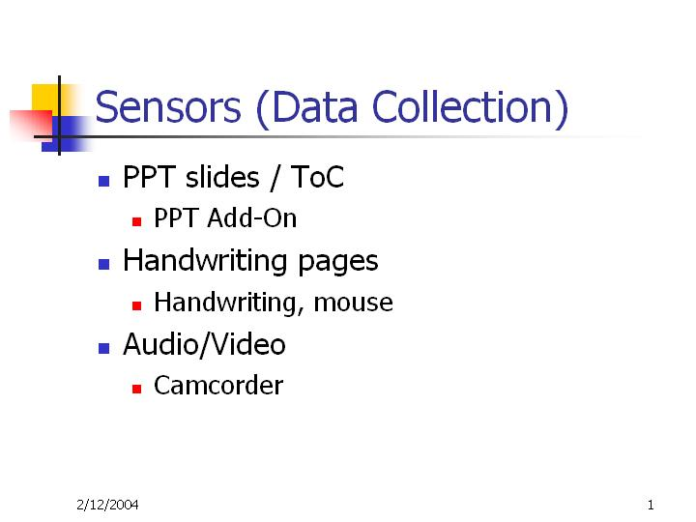
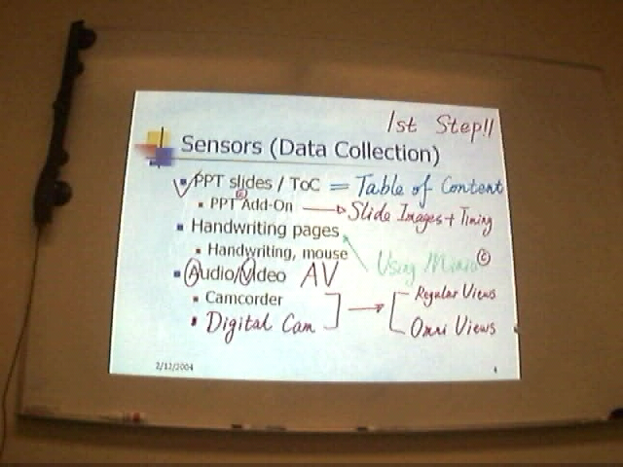
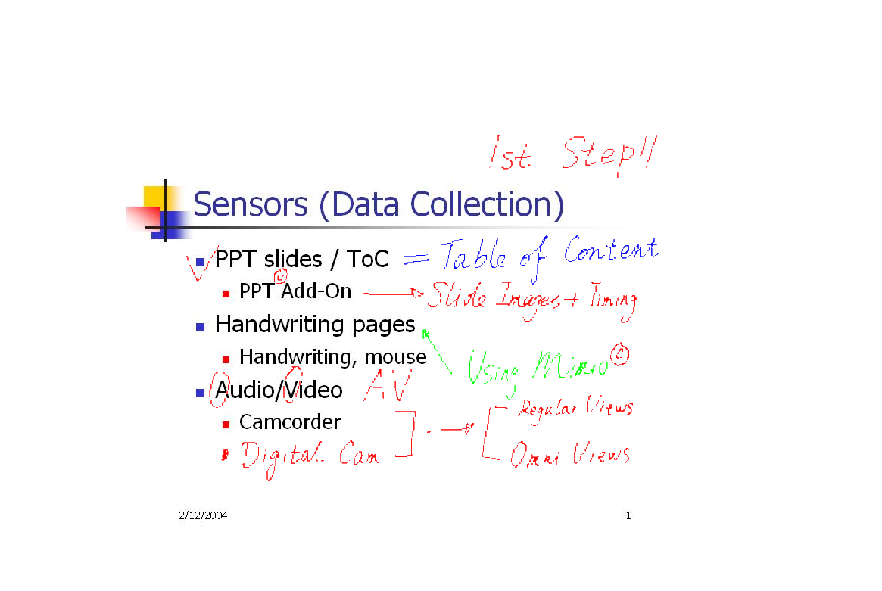
Handwriting pages
video
PPT slides
V1
S
H
V2
combined
Notes:
We used a Mimio Virtual Ink digital whiteboard system to capture a instructor’s handwriting on the whiteboard and saved it as an image.
The Powerpoint slide capturer was modified from the Berkeley PPT recording Add-In to save the ppt slides into JPEG image format.
****************************** 2nd part ********************
Here, in the dynamic approach, we use a camera as a bridge to align PPT slide and Mimio handwriting image.
Intuitively, this dynamic approach includes three steps: alignment of PPT slide with video frame; alignment of handwriting image with video frame and finally alignment of PPT slide and handwriting image.

Slide 14
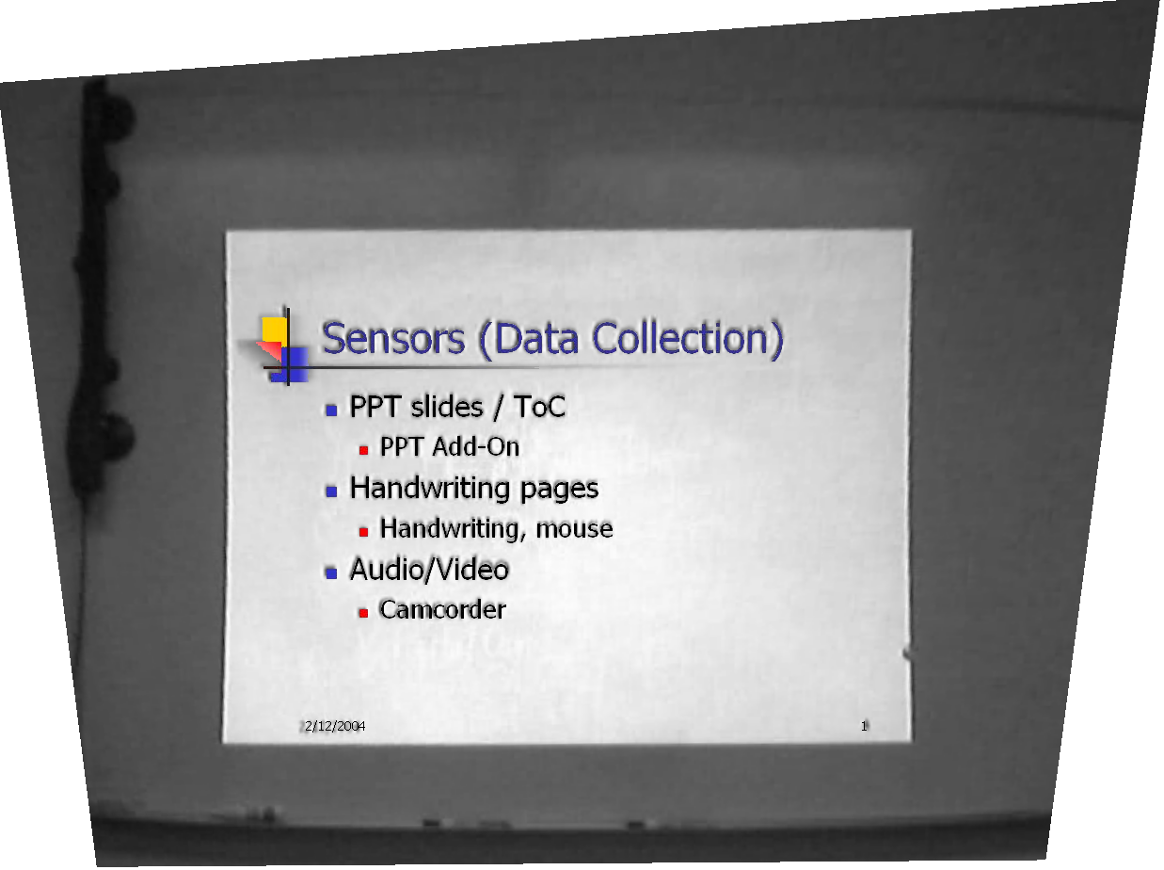
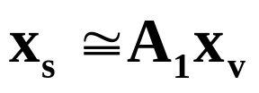
Slide and Video Registration
Distortion Removal
Feature Extraction
Image Transformation
Notes:
First step is to register slide and video.
The idea is to superimpose the slide onto the projection area of the video frame, and transform the combined image such that the rectified view of the ppt slide remains.
Because the video frames usually have radial distortion, we applied the calibration method proposed by Dr. Zhang at Microsoft Research to remove the radial distortion. And then, since the projection area is usually significantly brighter than other areas, we can first obtain the edge image and then apply the Hough transform to extract the four boundary lines to get the four corners. After that, we can transform the extracted projection area in the video frame to a rectified view and register the video frame with the ppt slide.

Slide 15
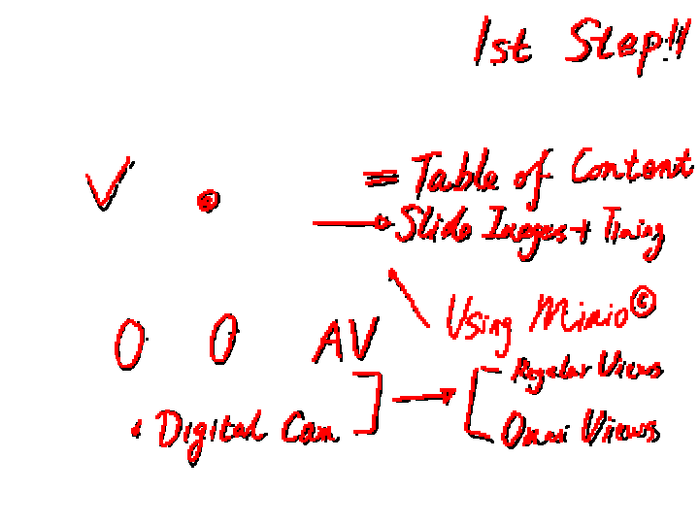
Video and Board Registration a two stage algorithm
(1) Initial Matching
  handwriting extraction
  Translation via centroid
  Scaling via polar profiles
(2) Fine Registration
  connected components
  content-based matching
  Projective transformation
Notes:
The video and whiteboard integration is more challenging, since the camera cannot “see” the invisible frame boundary of the whiteboard image. [*****] The intuition behind this work is to match the handwriting contents from both images. We proposed a coarse-to-fine algorithm to do this job, and let’s first take a look at the initial matching.

Slide 16
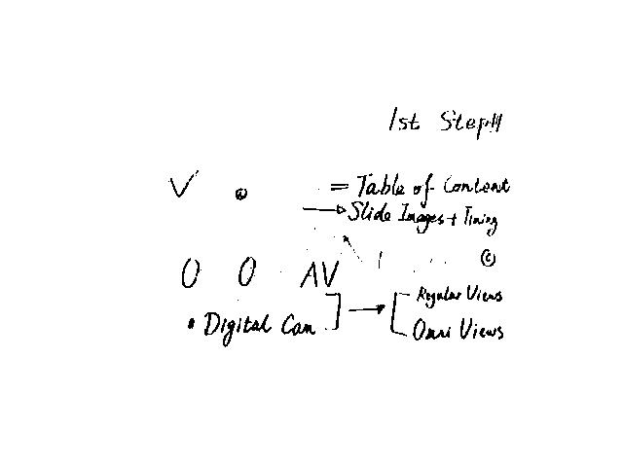
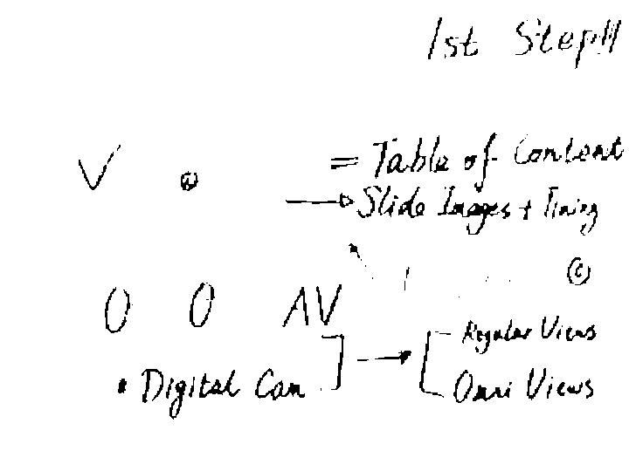
Video and Board Registration handwriting extraction
Notes:
The mimio image has already contained the clear handwriting contents, the same handwriting contents from video frames can be obtained by image subtraction.
To get the handwriting contents of video frames, we subtract the video frame with PPT projection only from video frame with both PPT projection and Mimio handwriting. After that, we apply the video to slide projective mapping matrix A1 to rectify the handwriting image

Slide 17
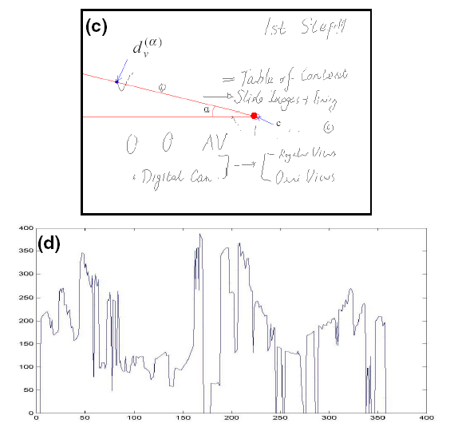
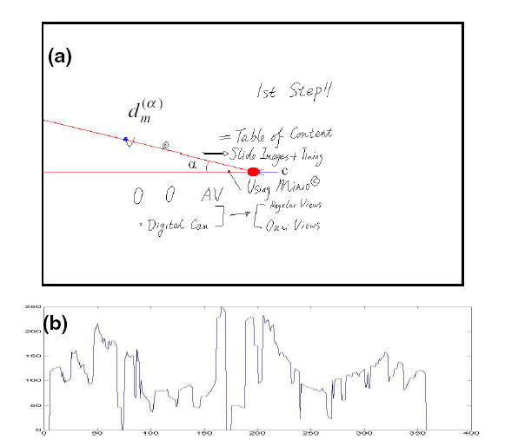
Video and Board Registration translation and scaling
Translation from centroids
Scale from polar profiles
Notes:
To initially match the two images, we need to know the translation and scale factor.
To get the translation, we calculate centroids for both images, which are indicated by the red dots, the difference of the two centroids will give us the translation of this two images.
To determine the scale factor, we generate a centroid-centered polar profile for both images by measuring the distances between the outmost stroke point and the centroid in all directions . The scale factor is given by the ratio of the area under the polar profile of both images.

Slide 18
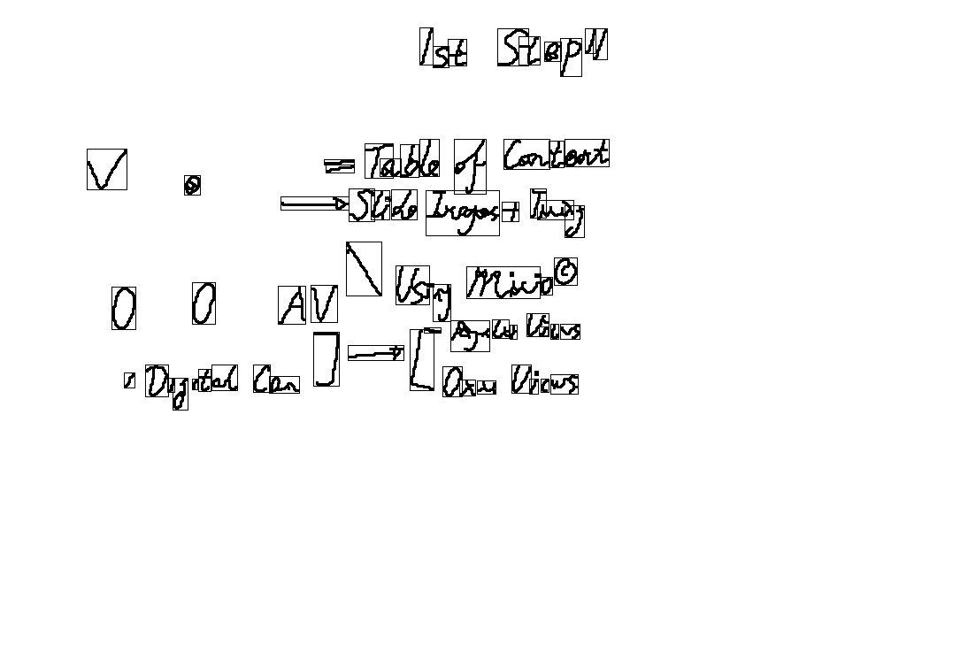
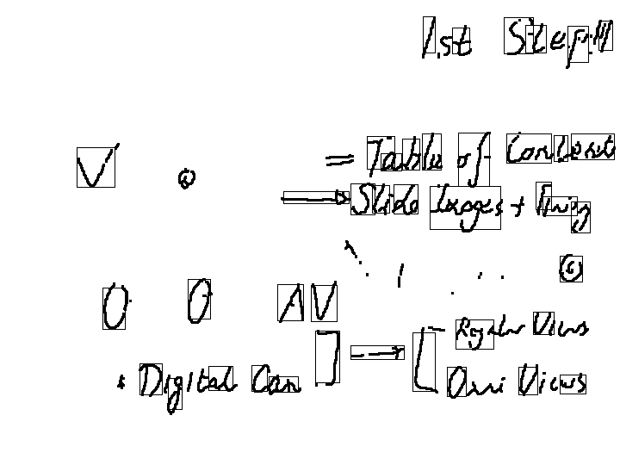
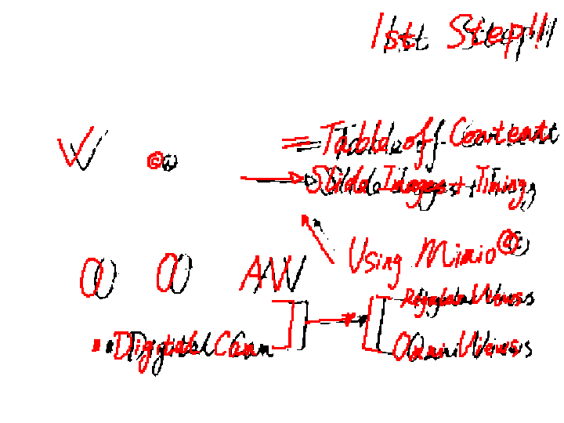

Video and Board Registration content-based matching
Notes:
After image translation and scaling, the two images are roughly aligned. To refine the alignment, We first extract the the connected components from Mimio image, which are indicated by the bounding rectangle boxes.
Then, the least square method is used to calculate the final 3x3 planar projective transformation matrix by choosing those matches whose normalized cross-correlation values are larger than a threshold.
After fine registration, the 3x3 planar projective transformation matrix A₂ can be used to register the PPT slides with the mimio handwriting image.

Slide 19
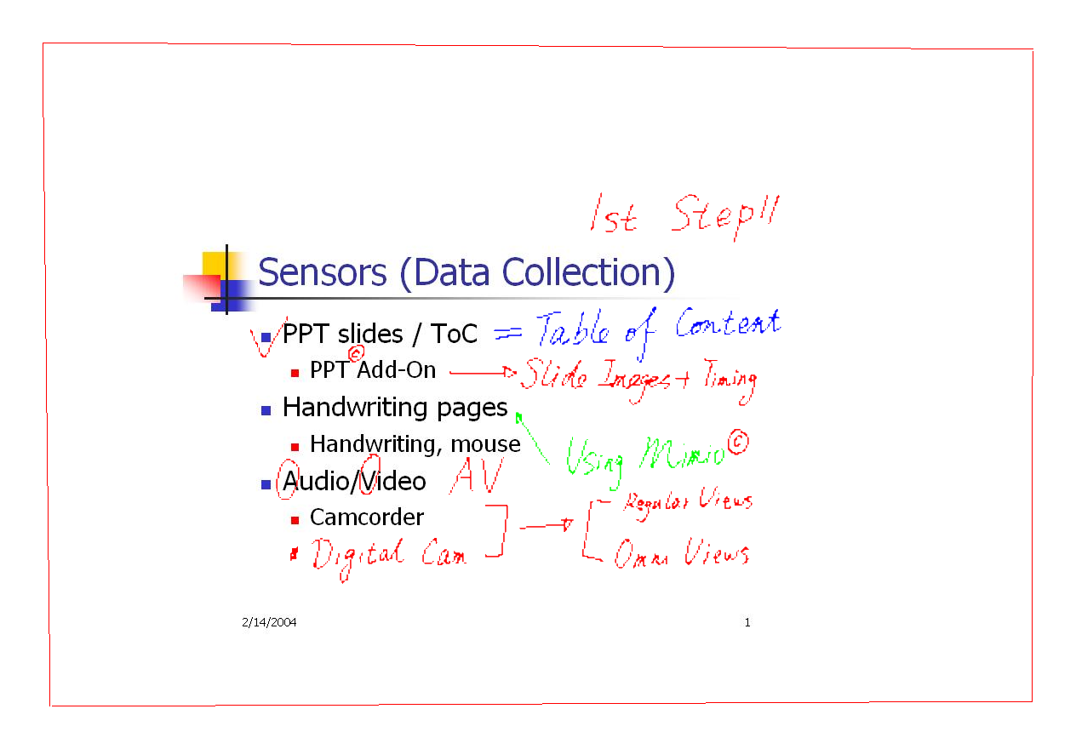

Slide-Board Integration
Notes:
We can see from the close-up that the two circles are perfectly registered from mimio image to Powerpoint slide.

Slide 20
Multimedia Presentation
IMC Presentation Creator
  Customizable media types (audio, video, PPT, etc)
  Adjustable position and size of media contents
IMC Presentation Player
  Synchronized media contents
  Popup Table of Content (TOC) for indexing
Notes:
21: creator; 22:player
We developed a graphical user interface for multimedia presentation, which is written in Java and includes two parts: the Creator and Player
As shown in this figure
The user can customize the presentation to include different media (video, audio, slide, handwriting pages and/or integrated pages) in windows with user-selected sizes and positions
As shown in this snapshot of the Player interface
all the media contents are synchronized by using the timing information. Also we can activate a pop-up table of contents to navigator the materials.

Slide 21
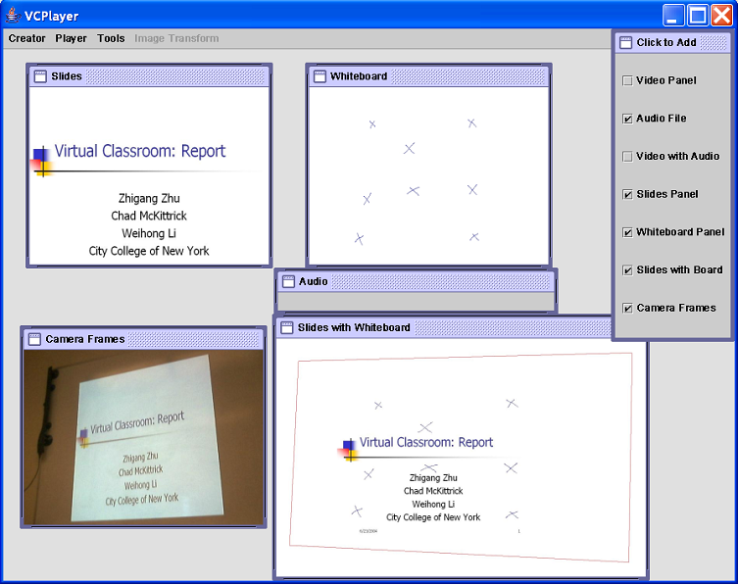
IMC Presentation Creator
Notes:
As shown in this figure
The user can customize the presentation to include different media, for example, video, audio, slide, handwriting pages and/or integrated pages) in windows, set the sizes and positions of the windows

Slide 22
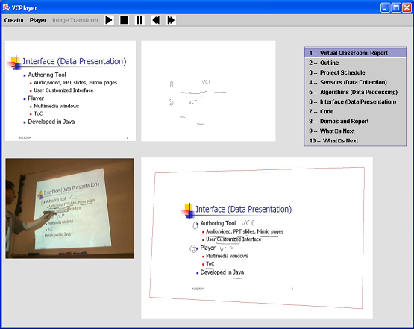
IMC Presentation Player
Notes:
As shown in this snapshot of the Player interface
all the media contents are synchronized by using the timing information (from the PPT log file, the whiteboard html files, and the video/audio timing information).
Also we can activate a pop-up table of contents to navigator the materials.

Slide 23
Speaker Tracking
Background Subtraction Based Tracking
  Adaptive background modeling
  Speaker extraction
Particle Filter Based Tracking
  Applied when any device movement is detected
  Initialized from previous speaker contour
  Accelerate adaptive background reconstruction
Notes:
The gesture and position of the instructor in classroom is important information and clue for a better learning experience for both the instructor and his/her students. Also, the position and contour image of the instructor is very important observation for activity recognition. To obtain this information, we have to first track the instructor and get its contour image.
We used two tracking strategies here, one is the …, the other one is PFT.

Slide 24
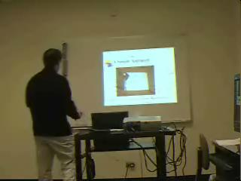
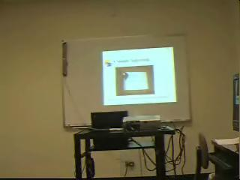
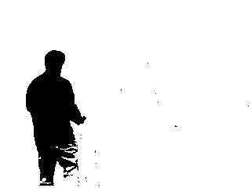
Background Subtraction
Prerequisites for Background Subtraction
  Clear background frame
  No device movement
Adaptive Background Modeling
  Illumination change
  Devices movement
Classroom scene Background frame Extracted speaker
Notes:
The simplest approach for tracking in the classroom scenario is to use background subtraction, which assumes that the camera is static and a clear background frame is obtained in advance.
The advantage of background subtraction based tracking is its computational efficiency and accuracy, therefore a real-time performance can be easily achieved.
It can be seen that the speaker was extracted fairly accurately though there are some missing foreground pixels in the parts of legs due to similar foreground-background pixel values.
However, the background subtraction based tracking will be invalid when
First, the illumination conditions in classroom changes due to the changes of slides, media playing, instructor’s movements.
Secondly, the camera or other devices moves during the class. If any devices are moved, the background frame needs to be updated again.
Therefore, we adopt an adaptive background modeling to update the background frame, which models recent history of each pixel, using a mixture of K Gaussian distributions .

Slide 25
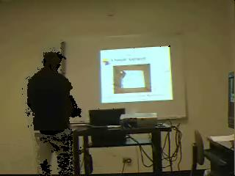
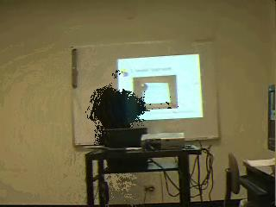

Particle Filtering
Applied when movement is detected
Initialized by previous speaker contour
Accelerate background frame reconstruction
Frame 61 Frame 631 Frame 1051
Notes:
If the movement of any devices (camera, projector, or Mimio capture bar) is detected, the particle filter tracking would be used to track the speaker.
And the PF tracking can be initialized by the speaker contour obtained by background subtraction in previous frames.
The purpose of the PF tracking is to provide a prior knowledge (foreground object) for adaptive background modeling and therefore accelerate the background updating process.
These images shows a sequence of background frames updated from a video clip of a classroom scene using the adaptive background modeling approach without prior knowledge of the speaker contour. The background updating process is not completed until frame 1051 i.e., around 30 seconds. With the prior knowledge of foreground and background pixels provided by PF tracking, this process could be done around frame 631 (Fig. 5b). Certainly, the updating speed also depends on the movement of the speaker.

Slide 26
Outline
Introduction
Previous Results
  Multimedia Integration
  Multimedia Presentation
  Speaker Tracking
Research Proposal
  Active Objects based Interaction
  Multimodal Layered HMM (ML-HMM)
Summary, Discussion and Timeline
Notes:
Now, let’s take a look at the system framework and research proposal

Slide 27
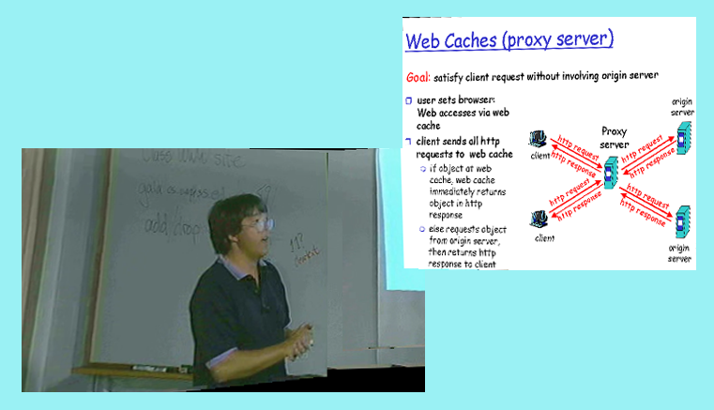
Active Objects
Definition
Active Objects
  Image of a speaker
  Notes in the integrated image
  Table of Content in IMC
Presentation
  New interface
  MPEG 4/7
  HTML with SVG (XML based)
Active WWW link
Synthetic digital display
Annotated instructor
Notes:
We treat every meaningful object as active in the Intelligent Multimedia Classroom.
This is an demonstration for active objects.
First, the image of the instructor is active not only because it is dynamic but it also is annotated and linked to his/her important information such as his/her web page, contact information, course materials, and etc. By clicking the image of the instructor, a student can find this information and may also ask questions on the spot, or make an appointment by sending him/her email
the synthetic images of the digital slides and whiteboard are also active with a glossary and dictionary, remedial tutorials, WWW links, and audio/video clips that may be presented in the original lecture
After a class is over, the TOC will be generated in IMC system and provide an index for students and help them to navigator the organized multimedia materials to desired positions easily
All these active objects could be presented in our own presentation interface or a standard interface, such as MPEG 7, or scalable vector graphics (SVG), a XML based language for describing 2D graphics and web application. We prefer to use HTML, however, more feasibility research still needed to be done.
The advantage of using active objects for interaction and presentation in classroom is first, active objects are intuitive and convenient means for interaction between students, instructor and computers; they can be naturally used for content-based data compression, which needs much less information to represent the original data, especially for images and videos. With content-based data compression, much smaller bandwidth is required for data transmission, which makes a real time presentation for students possible.

Slide 28
Architecture of the ML-HMM
HMMs for Events/Activities Recognition in Classroom
Activity Layer
HMM classifiers with longer time granularity T'
HMMs classifiers for audio signal
HMMs classifiers for video signal
Action Layer
HMM classifiers with time granularity T
Video feature extraction
PPT slides operation history
Mimio operation history
Audio feature extraction
Notes:
This is the architecture
Our proposed Multimodal and Layered Hidden Markov Model (ML-HMM) has three processing layers, with a two-level cascade of multimodal HMMs as shown in the figure.
The lowest layer captures video, audio, handwriting and PPT slide operation history and computes the feature vectors for analysis.
The middle layer, called action layer, is the first level cascade of HMMs and consists of two sets of distinct HMMs for classifying the audio and video feature vectors, respectively, with longer time window duration
the third and highest layer, also called activity layer, contains several sets of HMMs, which classifies events and activities with longest temporal granularity. The layer takes the inferential results from action layer, as well as the handwriting and PPT slides operation history information to construct a feature vector for analysis.
Let’s first take a look at the first processing layer…

Slide 29
Feature Extraction
Audio Features
  Spectrum Energy Envelop & Speech Energy
  Linear Predictive Coding Coefficients
Video Features
  Speaker Contour Image
  Image motion
    Entire image motion
    Particular rectangle region motion
    Upper left small region motion
  Head, trunk and hands position
PPT and Mimio operations history logs
Notes:
For audio feature extraction, signal energy is computed to determine the speech volume and the short time spectrum energy envelope is used to estimate the speaking rate. Also, linear predictive coding (LPC) coefficients are computed to classify sound type: Human speech; Animation or music sound;Ambient sound ; Silence, etc .
With respect to the video signal, the following features are extracted:
the contour image of the speaker obtained by background subtraction, after having learned the background;
the motion in the image obtained by image differences, which includes three parts, namely entire image motion (camera movement), particular rectangle region motion (projector movement) and a small upper left region motion (Mimo capture bar movement);
the head, trunk and hands positions are obtained for human activity recognition based on the contour image of the speaker by using a simple human body model. We will take a look at the body model in the next slide.
And PPT slide presentation operation history and Mimio handwriting operation history are logged down, such as changing slides, playing animation, creating new page, writing on the whiteboard, etc These logs will be used as a observation for event and activity recognition.

Slide 30
Action Layer Inference
Audio HMMs classifier
  Voice Types
    Human speech
    Animation or music sound
    Ambient noise
    Silence
Video HMMs classifier
  Person Presence
    Nobody
    Someone
  Background Motion
    Background change
    No background change
Notes:
The middle layer is this action layer.
The features extracted by the first processing layer are used as the observations for HMMs in the action layer.
The audio HMMs classify audio signals based on the audio features from the first processing layer, and one HMM is trained for each of the following classroom sound: human speech, animation and music sound, silence, and ambient noise.
On the video side, a set of HMMs is trained to detect whether nobody, someone, no background change, and background change are present in the classroom.
Three mutual exclusive HMM sets are defined in this layer, namely voice type set (consists of all kinds of sound); person presence set and background motion set. This means that three output will be generated for each time granularity in this layer.

Slide 31
Activity Layer Classification
Observation data
  Action Layer Inferential Results
    Audio HMMs (1)
    Video HMMs (2)
  PPT add-on logs
  Mimio system logs
Different data sources for classifications
Other activities and events
  New ones can be added into framework accordingly
Notes:
The highest layer in our proposed ML-HMM is activity layer.
The activity layer take the inferential results from action layer, as well as the handwriting and PPT slides operation history information as the observations. They construct a feature vector for HMMs in this layer to infer high level classroom activities.

Slide 32
Category | Event/Activity | Data Source
SPEAKING | Volume too low | Audio, Video
 | Volume too high
 | Rate too fast
WRITING | Writing too fast | Video, Mimio
 | Fonts too small
 | Hard to understand
MOVING | Camera | Video, Audio, Mimio
 | Projector
 | Capture bar
POSITING | Facing directions | Video, Audio
 | Blocking too long
INTERACTION | Questioning/Answering | Video, Audio, PPT, Mimio
 | Eye-contact
 | Students' response
 | Animation playing
Notes:
Here, we list 5 categories possible events or activities classification. Each category corresponds to a set of HMMs for classification. The data sources for each category are also listed here.

Slide 33
Learning for ML-HMM
Layered parameters learning using forward-backward algorithm
Each layer HMMs can be learned separately
  Allows retraining for a particular layer
The dimensionality of the state space is smaller
  Less parameters than standard HMMs
  Less training data needed
Data collection and labeling
  A couple of classroom activity dataset
  Manually label the data as the ground truth
Notes:
The good thing about the layered HMM is that each layer of HMMs can be learned separately. Therefore, the modularity oif LHMMs allows the retraining of the layers that are most sensitive to environmental or sensor variation,which will reduce the burden of training during transfer among different environments.
Another advantage of layered HMMs is that the dimensionality of the state space that needs to be learned from data is smaller in Layered HMMs than that of their corresponding normal HMMs; therefore, Layered HMMs are less prone to overfitting problem than HMMs and also need less training data.
We will record and collect a couple of classroom activity dataset (totally around 120 minutes), and manually label the data as ground truth for training and testing. The first few seconds of each dataset will be ignored due to the lag of the models in recognizing each activity. We will use part of the data (e.g., 50%) for training, and the rest of the data for testing. The training and testing data will also be used for performance evaluation.

Slide 34
Performance Evaluation
Layered HMM (LHMM) v.s. HMM
  Training and Testing
  Accuracy
Multiple modality LHMM v.s. Single modality LHMM
Evaluation Criteria
  Normalized Log Likelihood
  Confusion Matrix
Notes:
We will evaluate our proposed multimodal-layered hidden Markov model on data collected in the classroom. Two different sets of experiments will be carried out. The first set of experiments will be focused on training and testing the layered HMM and a normal HMM and the performance comparison between them will be evaluated. Another set of experiments will be focused on training and testing multiple modality layered HMM and single modality layered HMM. Both the normalized log likelihood and confusion matrix will be used as the criteria for comparison.

Slide 35
Outline
Introduction
Previous Results
  Multimedia Integration
  Multimedia Presentation
  Speaker Tracking
Research Proposal
  Active Objects based Interaction
  Multimodal Layered HMM (ML-HMM)
Summary, Discussion and Timeline

Slide 36
Summary and Conclusion
Intelligent Multimedia Classroom
Related Work
Previous Results
Proposed Research Issues
  Active Objects
  Multimodal Layered HMM
Publication List
  8 papers published
Notes:
In summary, we have proposed an IMC system, which has three important components, (namely, Automatic data collection, integration and presentation; Flexible interaction based on active objects; Real-time multimodal activities recognition). And shown some preliminary results are shown, including multimedia integration and speaker tracking.
Our proposed research issues…
For active objects interaction, we will explore how to extract the active object efficiently and also explore how to present them for better interaction.
For ML-HMM based events and activity recognition, we will explore what features are good for recognition.
Also, we will study the difference between single modality and multiple modalities for infer those events and activities.
We will also explore the advantage of layered HMM compared with regular HMM.
We will also study how to add new event and activities into this layered HMM efficiently.
And finally, we will study how hard it is to apply this model to other human-computer interaction applications.
Currently, eight papers have been published, [[[which closed related or related to our IMC system. ]]]

Slide 37
Publication List
1. W. Li, H. Tang, C. McKittrick and Z. Zhu, Classroom Multimedia Integration for Advanced E-Presentation, IEEE International Conference on Multimedia & Expo (ICME), pp 1297-1300, Toronto, Canada, Jul 2006.
2. W. Li, Z. Zhu and G. Wolberg, Remote Voice Acquisition in Multimodal Surveillance, IEEE International Conference on Multimedia & Expo (ICME), pp 1649-1652, Toronto, Canada, Jul 2006.
3. W. Li, H. Tang and Z. Zhu, Vision-Based Projection-Handwriting Integration in Classroom, IEEE Computer Vision and Pattern Recognition Workshop on Projector-Camera Systems (PROCAMS), New York, June 2006.
4. W. Li, M. Liu, Z. Zhu and T. Huang, LDV Remote Voice Acquisition and Enhancement, IEEE International Conference on Pattern Recognition (ICPR), Hong Kong, China, August 2006
5. Z. Zhu, W. Li and G. Wolberg, Integrating LDV Audio and IR Video for Remote Multimedia Surveillance, IEEE Computer Vision and Pattern Recognition Workshop on Object Tracking and Classification in and Beyond the Visible Spectrum (OTCBVS), San Diego, June 2005
6. Z. Zhu, W. Li, Integration of Laser Vibrometry with Infrared Video for Multimedia Surveillance Display, Technical Report, TR-2005006, Computer Science Department, Graduate Center, CUNY, April 2005
7. W. Li, H. Tang, Z. Zhu, Automated Registration of High Resolution Images from Slide Presentation and Whiteboard Handwriting via a Video Camera, IEEE Computer Vision and Pattern Recognition Workshop on Image and Video Registration (IVR), Washington DC, July 2004
8. Z. Zhu, C. McKittrick and W. Li, Virtualized Classroom – automated production, media integration and user-customized presentation, IEEE Computer Vision and Pattern Recognition Workshop on Multimedia Data and Document Engineering (MDDE), Washington DC, July 2004

Slide 38
Timeline
Active Objects and Feature Extraction
  To be finished by the end of 2006
ML-HMM Model Implementation
  To be finished in the spring of 2007
  Start to write thesis afterwards
Dissertation Defense
  Dissertation defense by the end of the summer of 2007
Notes:
A rough timeline for the remaining research tasks is as following:
Feature extraction for probabilistic model is tightly related to active objects. They could be finished by the end of this year.
I will finish the model implementation in the spring of next year and start to write the thesis afterwards.
And finally, I will defense my dissertation by the end of next summer.

Slide 39
Thank you!
Notes:
Q/A:
Why HMM instead of BNs.
Why layered HMMs
Body model details
Spectrum Energy Envelop
Blocking should have a action layer: overlaying of body and projection area.
Instructor assistant probabilistic module and data processing in Framework of IMC
Separate module, so, OCR and Add-on is used for SA module
For IA module, the features are in history logs.
Speech energy envelop paper for some details.
Should we change the activity layer picture? It’s ok, just say something about it.
Adaptive background modeling slide?

